Slide 1
HAND-et V2
A2Z
Notes:
Em

Slide 2
Objectives
Main Objective: Rapid prototype a prosthetic hand device with trumpet playing capabilities and integrated learning features focused around non-physical aspects of trumpet playing.
Valve Actuation : Prototype mechanical system capable of actuating valves in time with sheet music.
Alignment: Prototype feedback system to alert player of prosthetic misalignment.
Rhythm: Prototype visual aid for timekeeping and mouth aperture to automated hand syncing.
Tone: Prototype live feedback system that evaluates the played note’s tone.
Notes:
Big idea into small subgoals that assist in each part of trumpet playing. All these things are harder to notice/adjust with no tactile feedback. Compress valves. How align prosthetic? Rhythm and time keeping? How do you know when the hand is going to start moving. Learning consistent rhythm hard. Tone? Very little to do with trumper itself all aperature

Slide 3
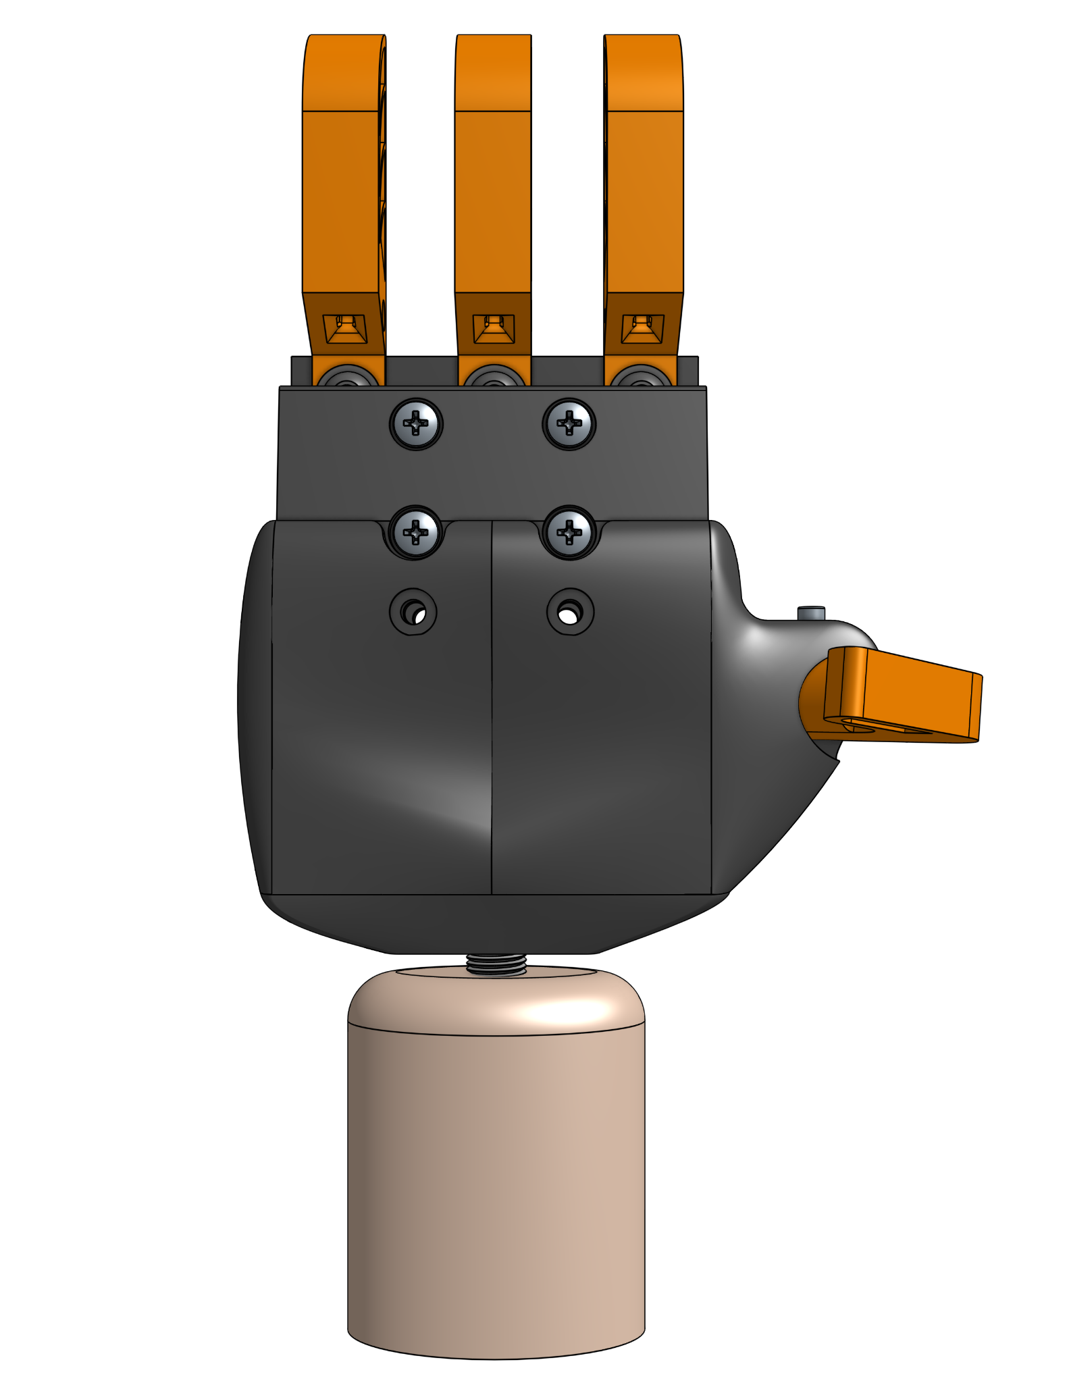
Background/Importance
Improve amputee mental health.
Lower barrier of entry for a new therapy and hobby.
Optimize individual practice sessions.
Innovate and develop upon previous work.
Figure 1: Front view of Hand-et version 1.
Notes:
Em

Slide 4
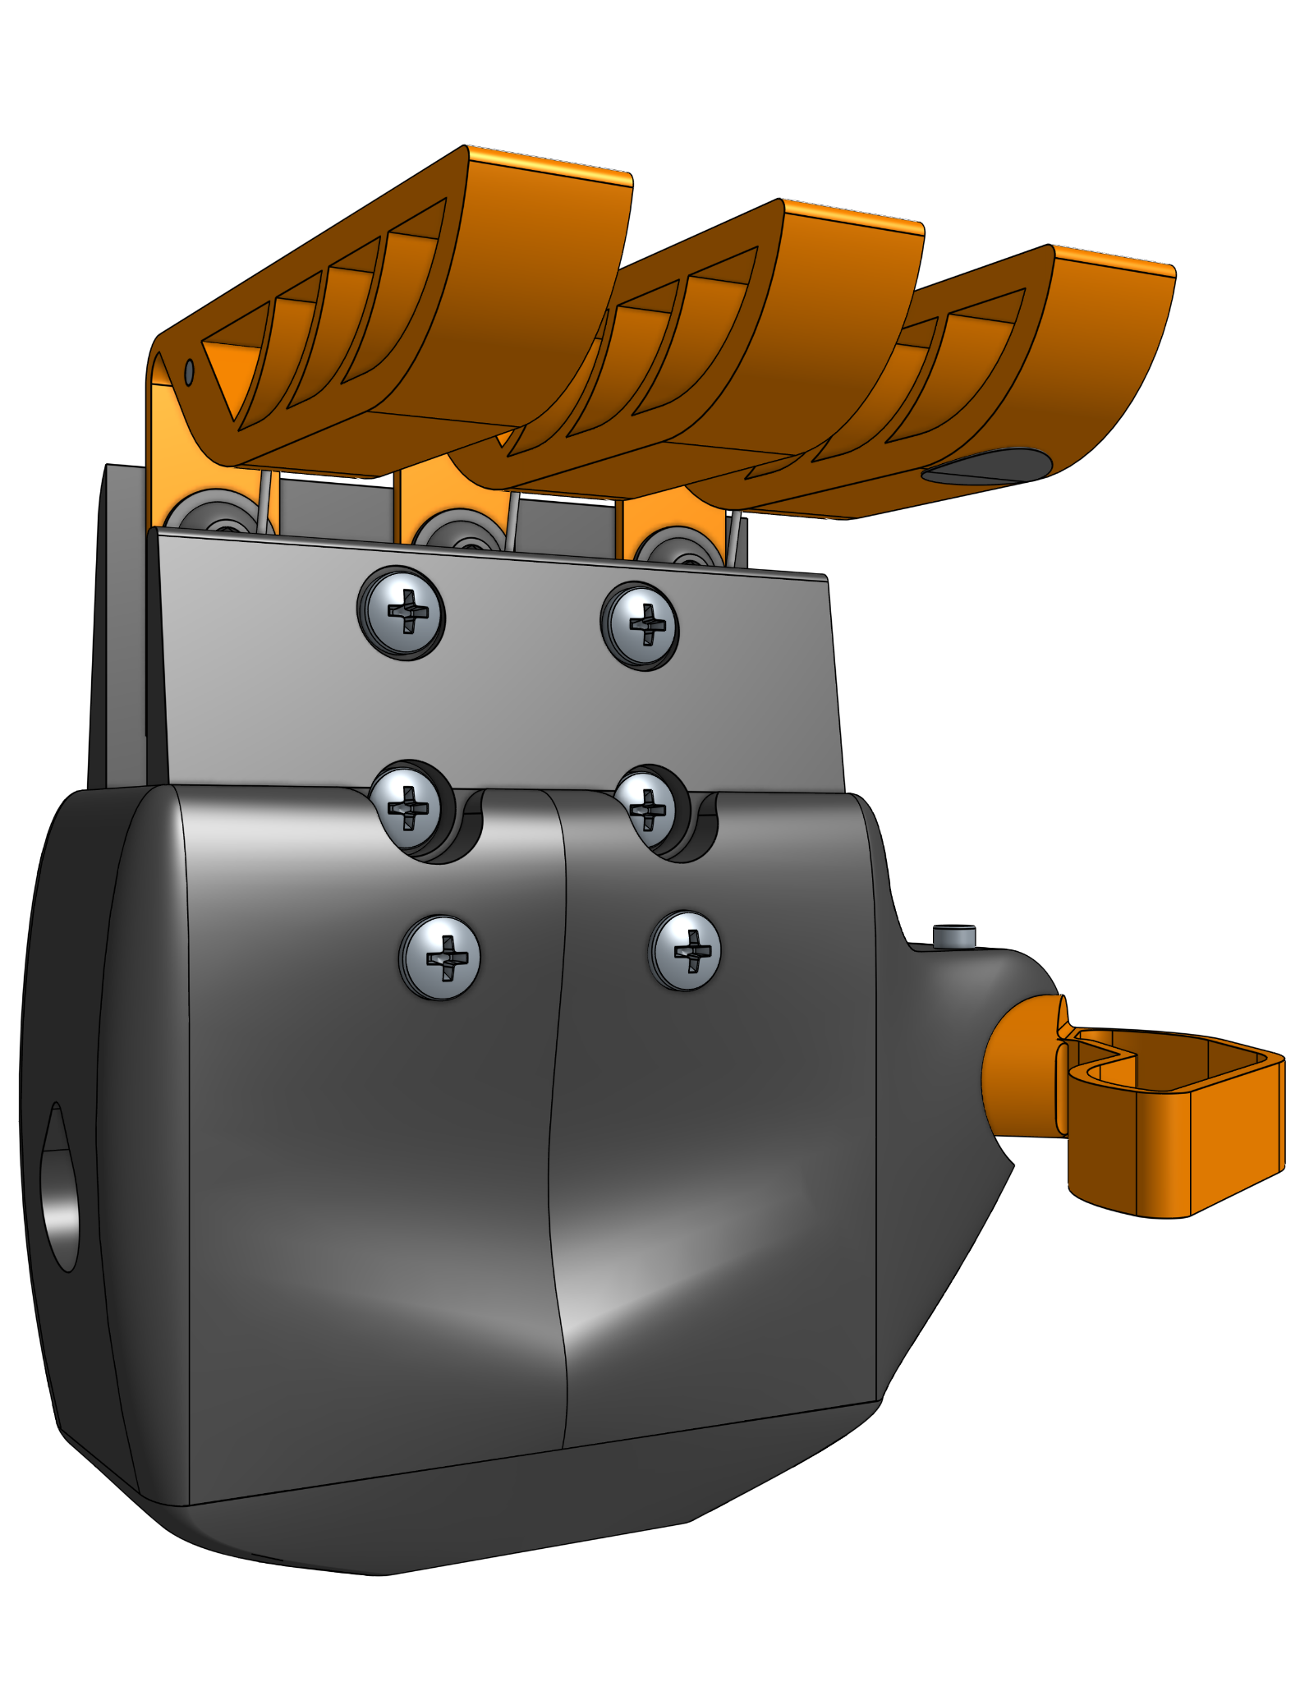
Proposal
Hand-et Redesign
Alignment Pressure Sensor
Visual Metronome
Real-time Tuner
Figure 2: Perspective angled view of proposed Hand-et V2 design.
Notes:
Em

Slide 5
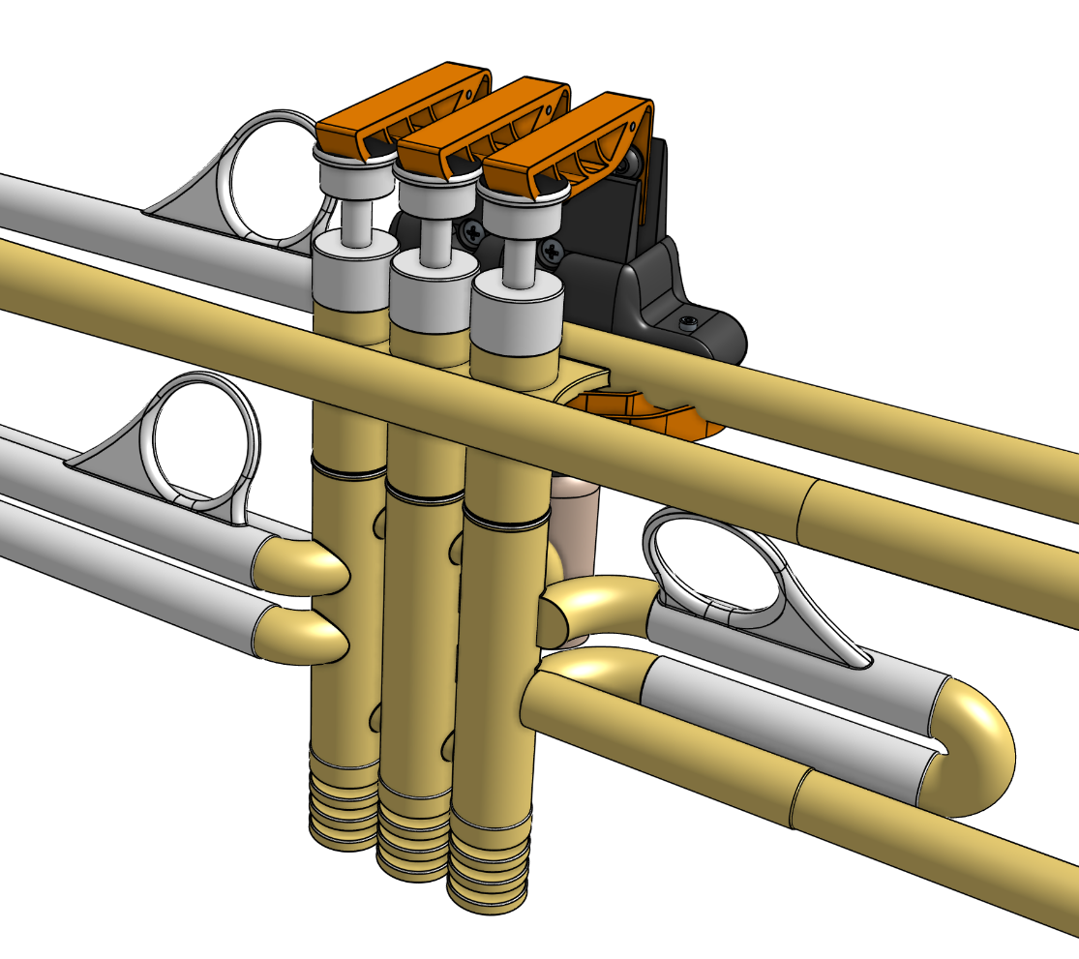
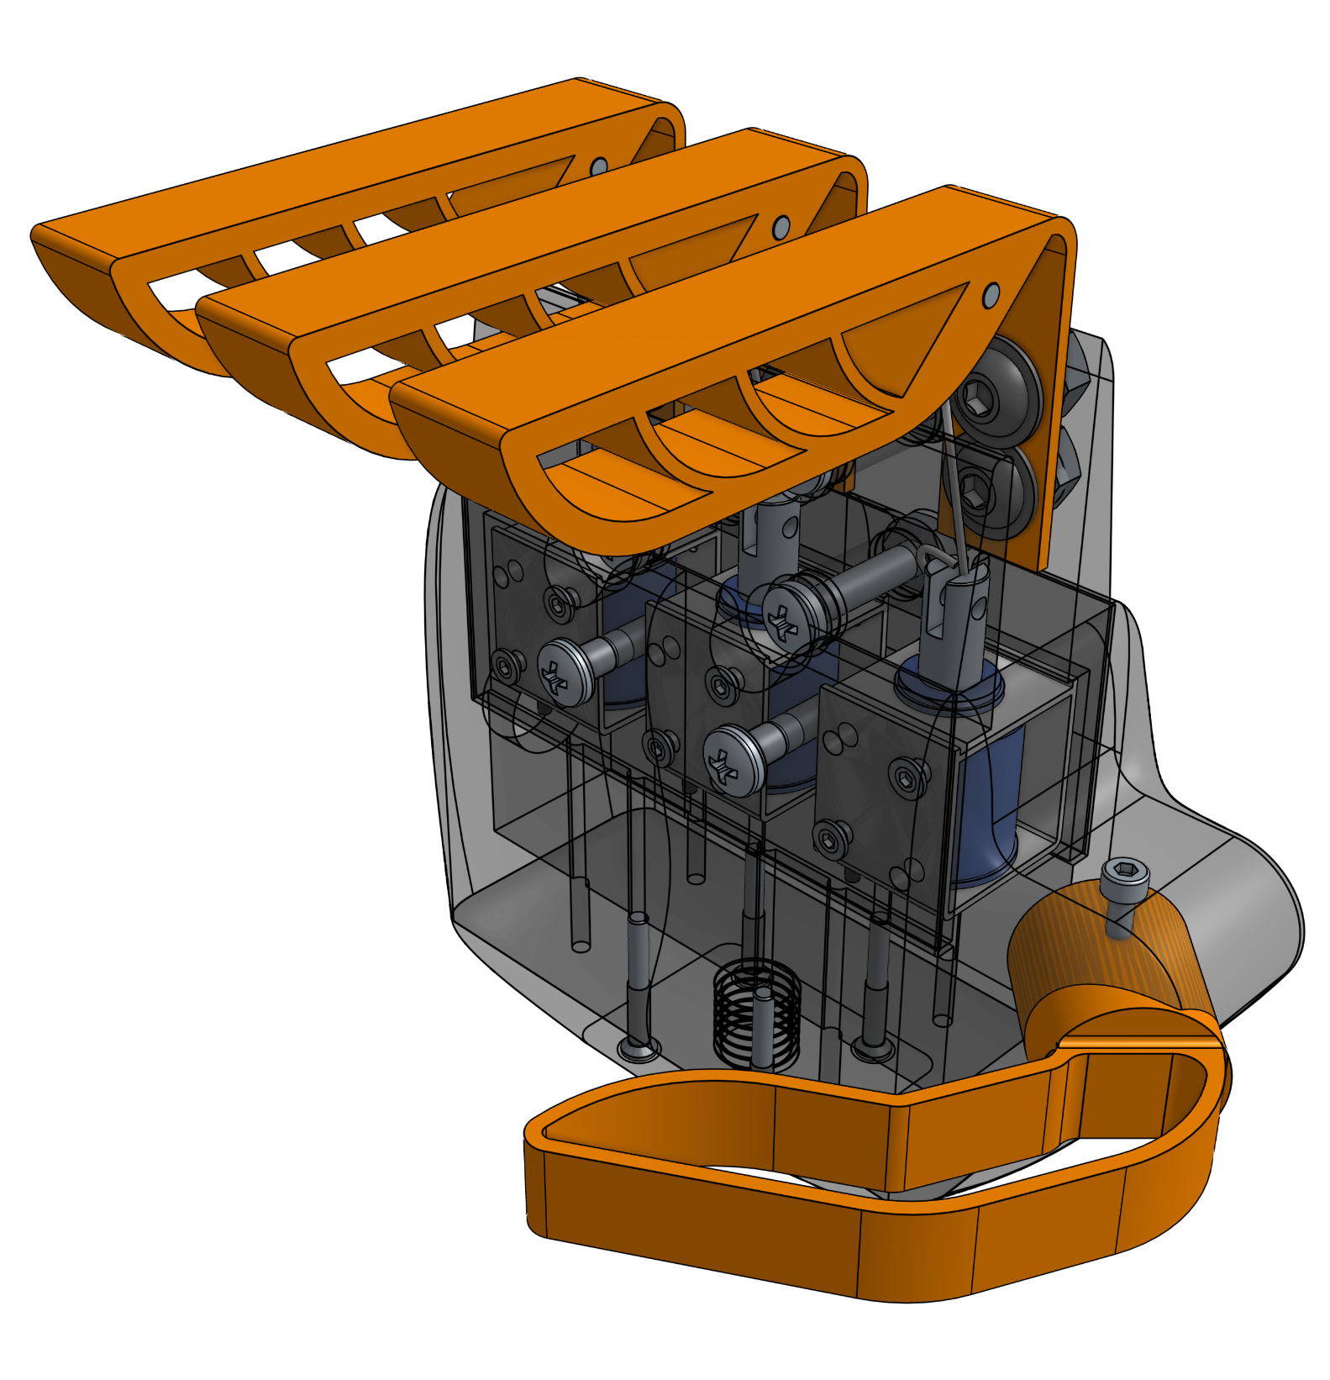
Hand Redesign
Angled digits
Increased digit durometer
Total thumb redesign
Higher force solenoids
6 to 20 N
Figure 4: Perspective view of Hand-et V2 on modeled trumpet with valves and proper alignment shown.
Figure 3: Isometric view of assembled Hand-et V2 design with transparent casing.
Notes:
Zoe

Slide 6
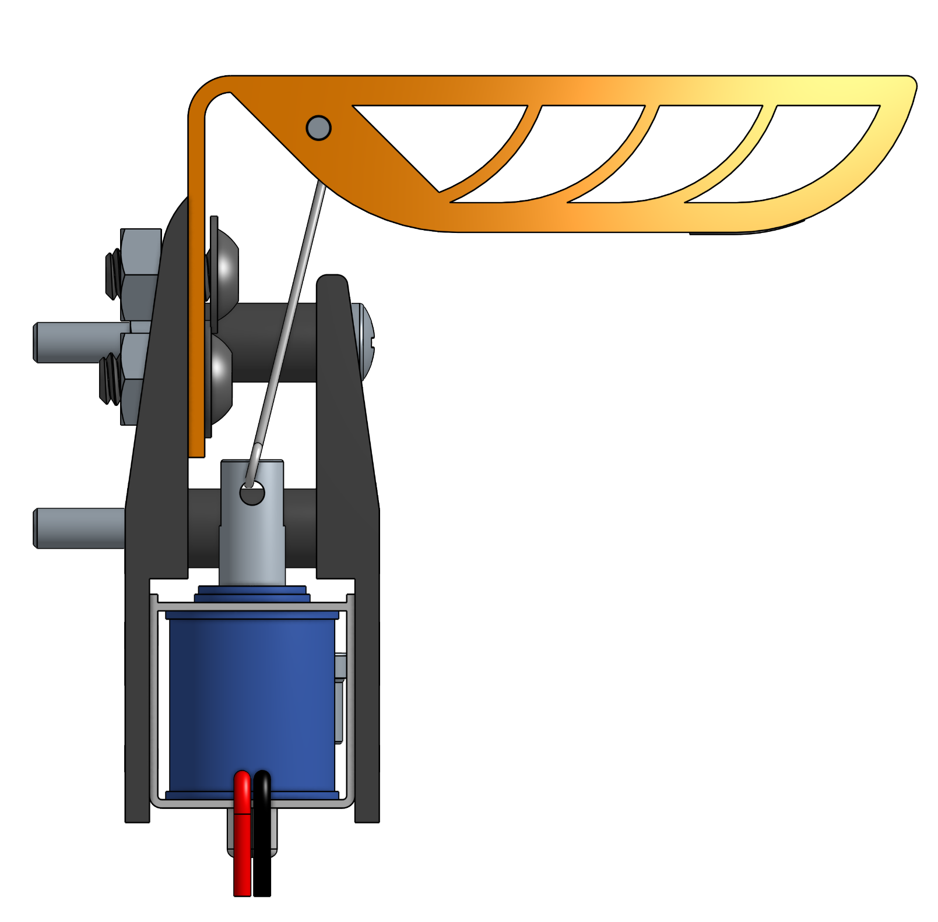
Pressure Sensor: Application
Goal: Provide a replacement mechanism for tactile feedback
Visual depth perception provides little feedback when trumpet in playing position.
Solution: Develop an easy to see visual indicator of whether a valve is being compressed properly.
Eye catching LED on hand or GUI
Figure 5: Side view of Hand-et V2 without external palm and hand casing.
Notes:
Zoe

Slide 7
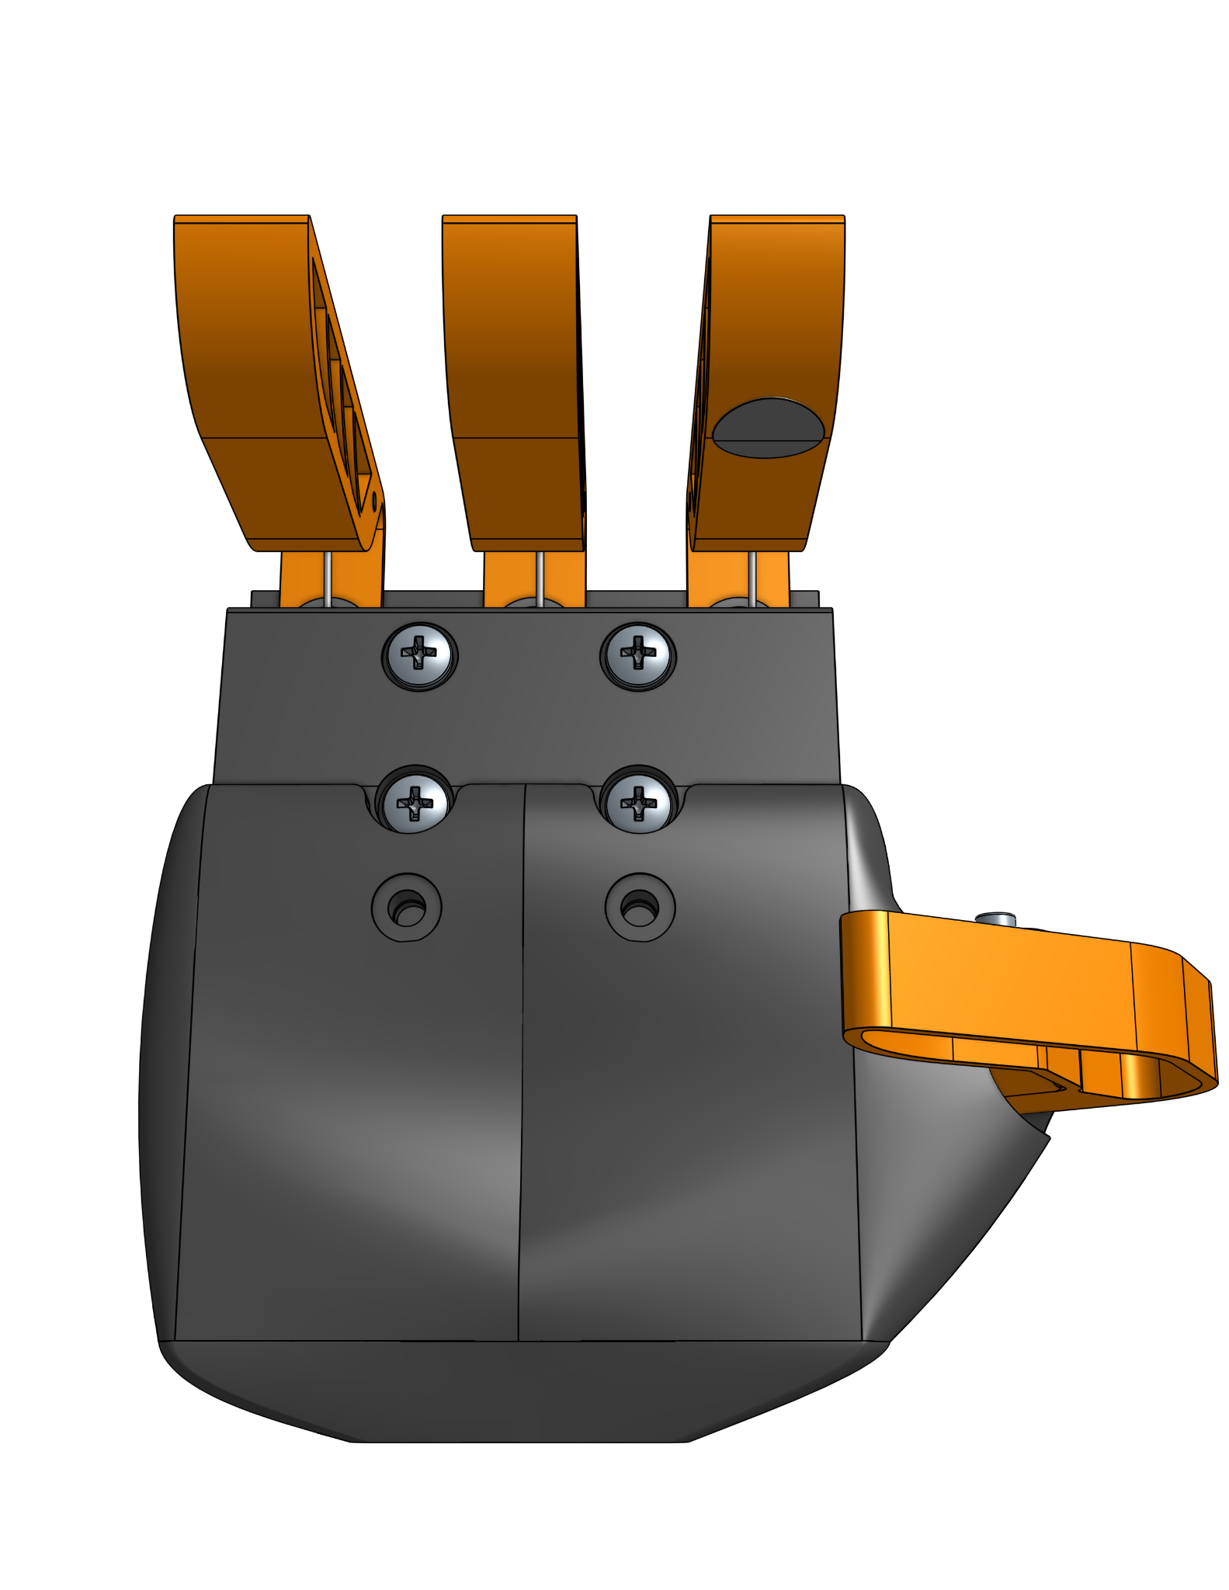
Pressure Sensor: Design Concept
B
Variable Resistor
Resistance of sensor changes as force is applied.
Single pressure sensor
Slightly less than 30% of the time alignment is being evaluated
Adhesive Backing
Easy application and adjustment for different trumpets
A
Figure 6: (A) Angled front view of Hand-et V2 with pressure sensor highlighted in an orange box. (B) Expanded view of panel A’s concentration box showing pressure sensor placement.
Notes:
Zoe

Slide 8
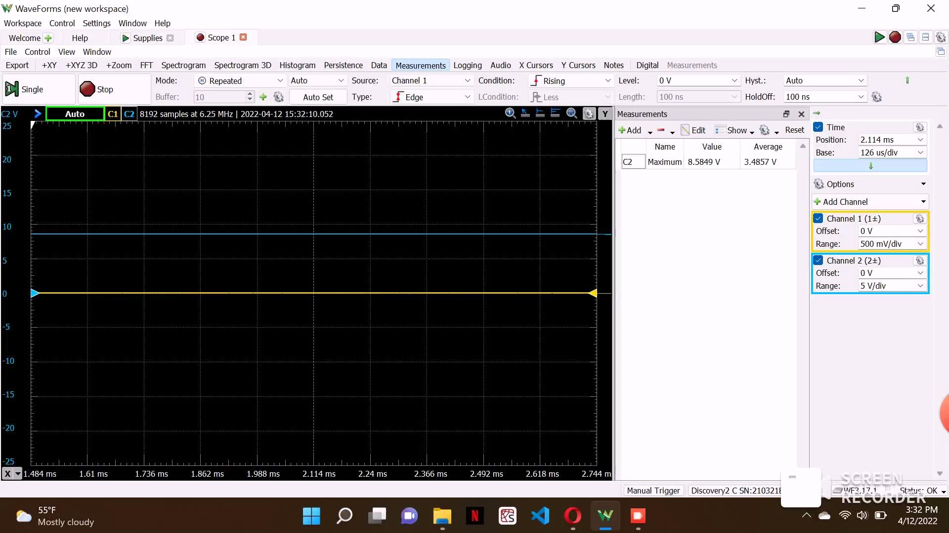
Pressure Sensor: Oscilloscope
Video 1: Video of the pressure sensor’s voltage response to the force applied to compress trumpet valve.
Notes:
Zoe

Slide 9
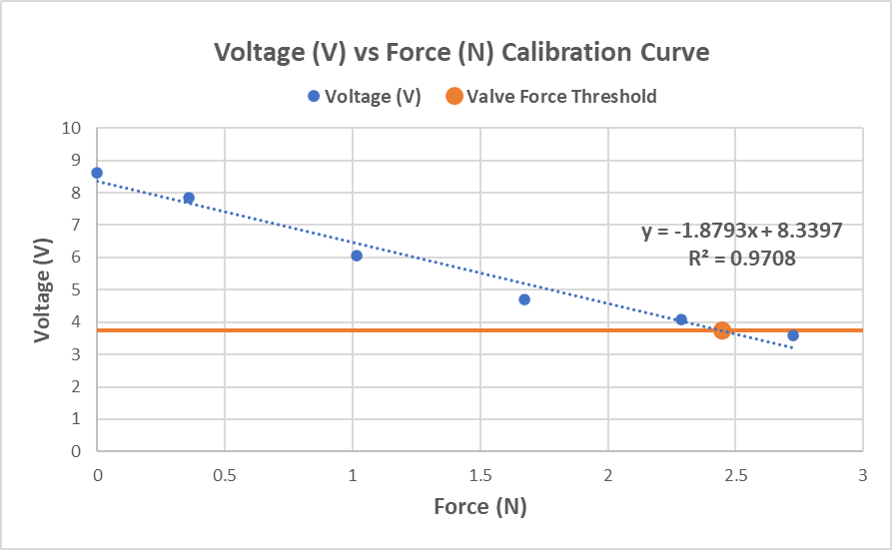
Pressure Sensor: Calibration
Figure 7: Calibration curve displaying the relationship between applied force (N) and voltage (V) output on the pressure sensor. Voltage threshold at 3.74 V shown in orange. Threshold generated from trend line and 2.45 N necessary for valve compression.

Slide 10
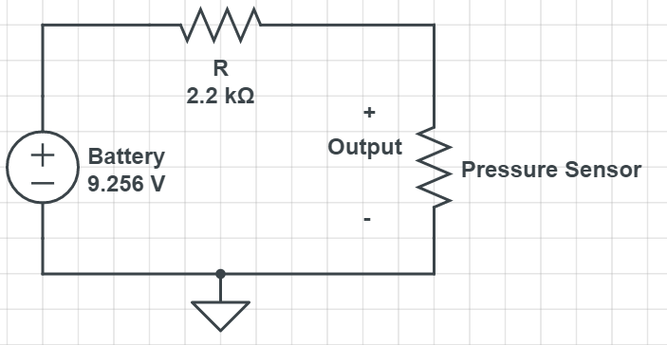
Pressure Sensor: Circuit Design
Voltage (V) | Resistance(Ω)
8.608 | 29224.69
7.834 | 12120.11
6.062 | 4175.45
4.711 | 2280.35
4.078 | 1732.64
3.593 | 1395.83
3.74 | 1487.65
Notes:
Anna

Slide 11
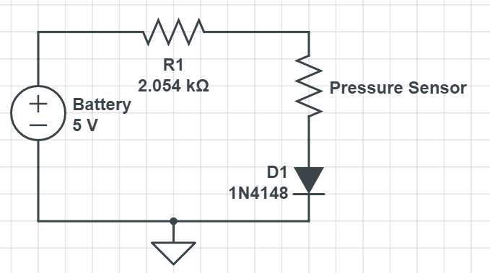
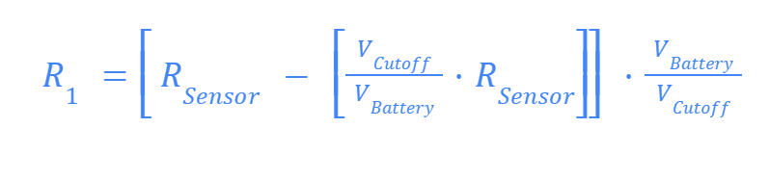
Pressure Sensor: Calculations
Threshold Resistance: 1487.65Ω
+
Output
LED Operational Voltage: 2.1V
-
Notes:
Anna

Slide 12
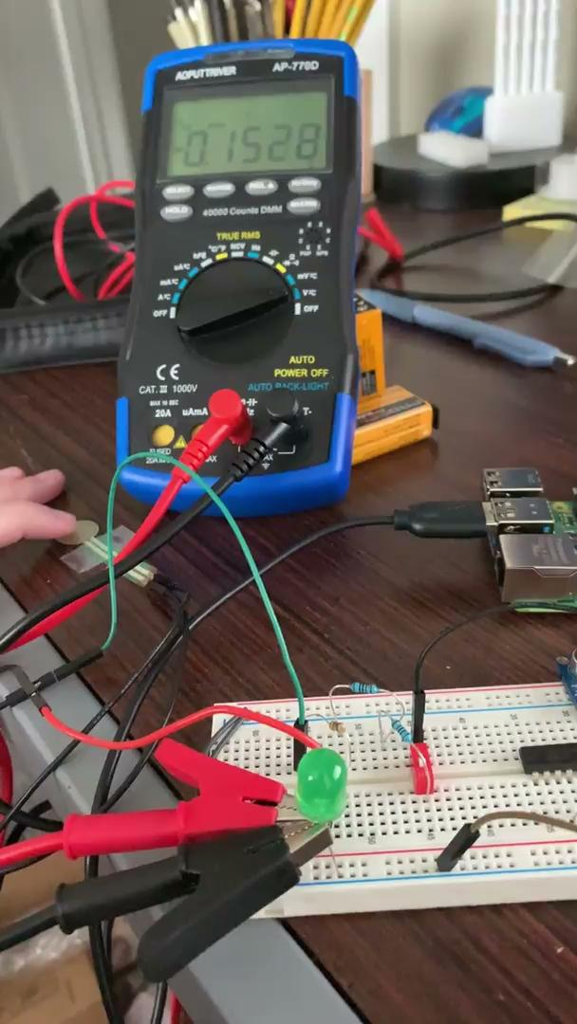
Pressure Sensor: Output
Video 2: Video of the pressure sensor’s binary response to the threshold force of 2.45 N at 2.1V.
Notes:
Anna

Slide 13
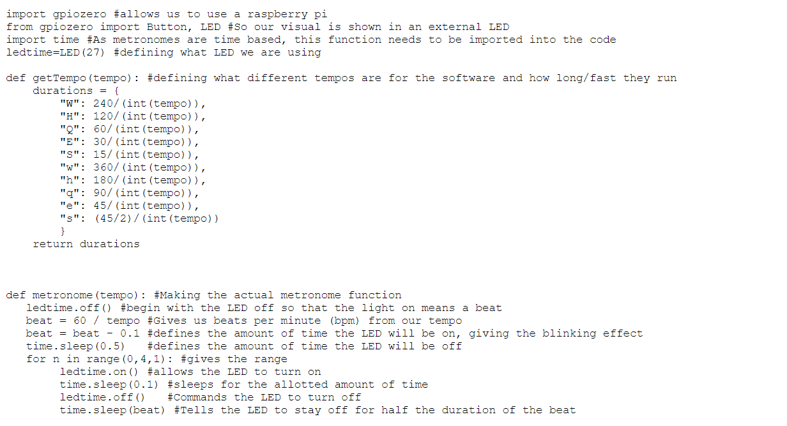
Metronome Building
Downloads
Definitions
Metronome
Notes:
Em

Slide 14
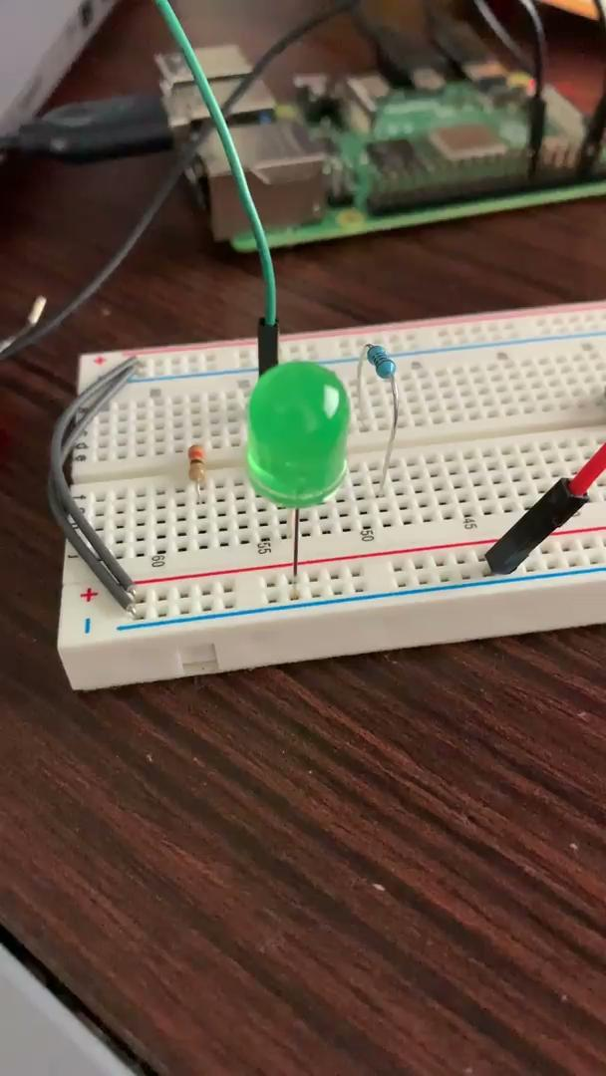
Metronome Testing
Video 3: LED metronome at 60 beats per minute.
Notes:
Em

Slide 15
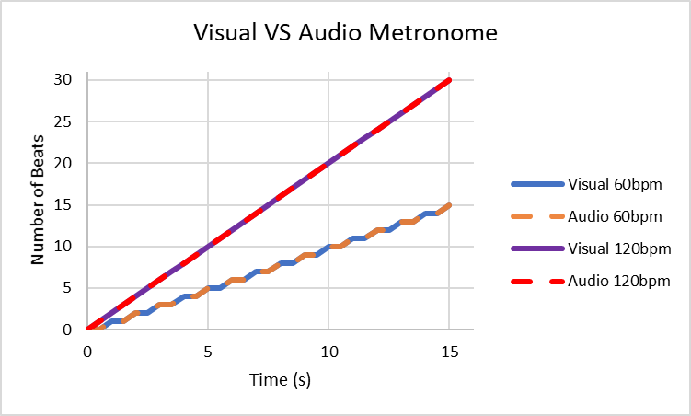
Metronome Analysis
Figure 8: This plot displays the visual and audio metronome beats versus time at both 60bpm and 120bpm. It is used to verify how accurate the developed LED metronome works both at different tempos and in comparison to a pre-existing audio metronome. Time spanned for 15 seconds, with beats measured every 0.5 seconds.
Notes:
Em

Slide 16
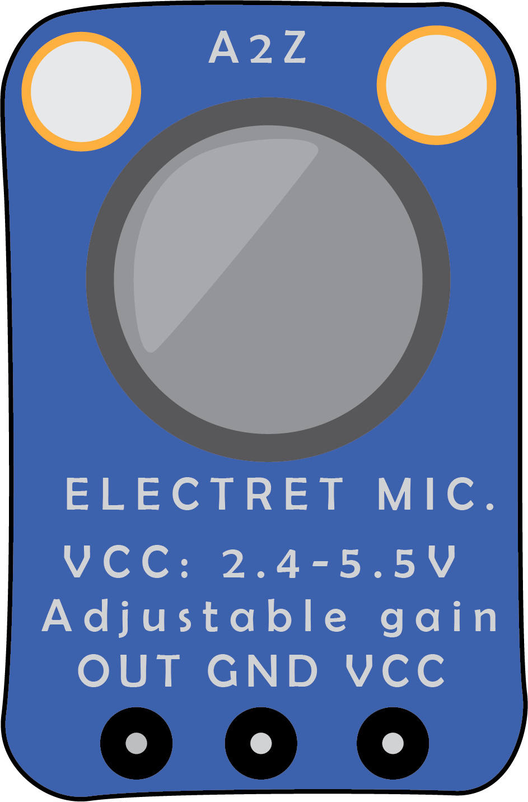

Real-Time Tuner: Application
Goal: Allow user to recognize pitch and adjust their playing accordingly
Notes:
Anna

Slide 17
Real-Time Tuner: Design Concept
Electret Microphone
Python Program
User Interface
Transduces acoustic waves to electronic signal
Range of 20Hz to 20kHz
Converts from time domain to frequency domain
Fast Fourier Transform
Backend program
Displays output frequency in real-time
Frontend program
Notes:
Anna

Slide 18
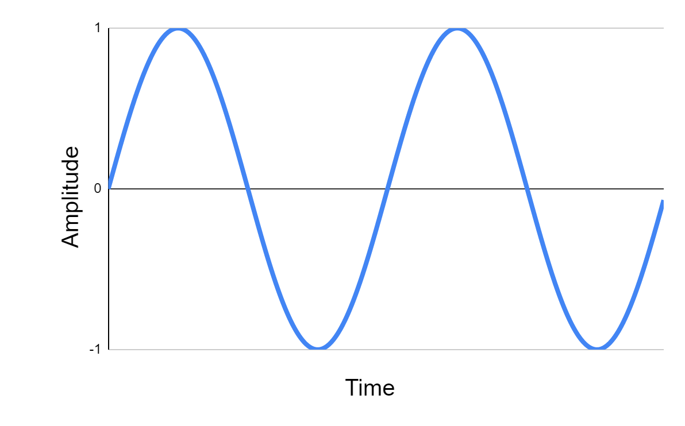
Real-Time Tuner: Transform
Time Domain
Frequency Domain
Decibels
10⁰ 10¹ 10² 10³ 10⁴ 10⁵
Frequency
Notes:
Anna

Slide 19
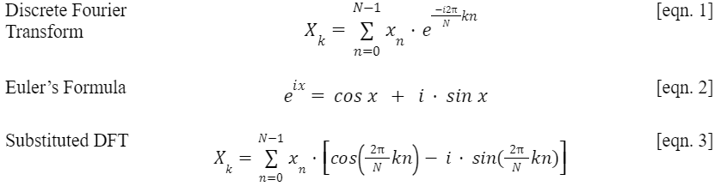
Real-Time Tuner: Fast Fourier Transform
N = Series of Complex Numbers
k = Wavenumber
n = Iteration
Notes:
Anna

Slide 20

Real-Time Tuner: Oscilloscope
Measurement taken on Analog Discovery 2 Oscilloscope
Constant C4 note played
Unstable signal
Video 4: Oscilloscope output from electret microphone
Notes:
Anna

Slide 21
Real-Time Tuner: Analog vs. Digital
Problem: RaspberryPi’s only accept digital inputs.
Digital
Analog
0
1
( 0 , 1 )
⋁
Boolean Data
Continuous Data
Notes:
Anna

Slide 22
Real-Time Tuner: Results
Video 5: Python program output from built in computer microphone.
Notes:
Anna

Slide 23
Conclusions
Alignment: Successful calibrated and implementation of pressure sensor system.
Rhythm: Visual metronome successfully implemented in GUI and LED system.
Tone: Frequency based tuning device concept developed.
Valve Actuation: Ultimately unsuccessful after multiple iterations of the force translation mechanism.
Figure 9: Perspective view of Hand-et V2 rotating.
Notes:
Zoe

Slide 24
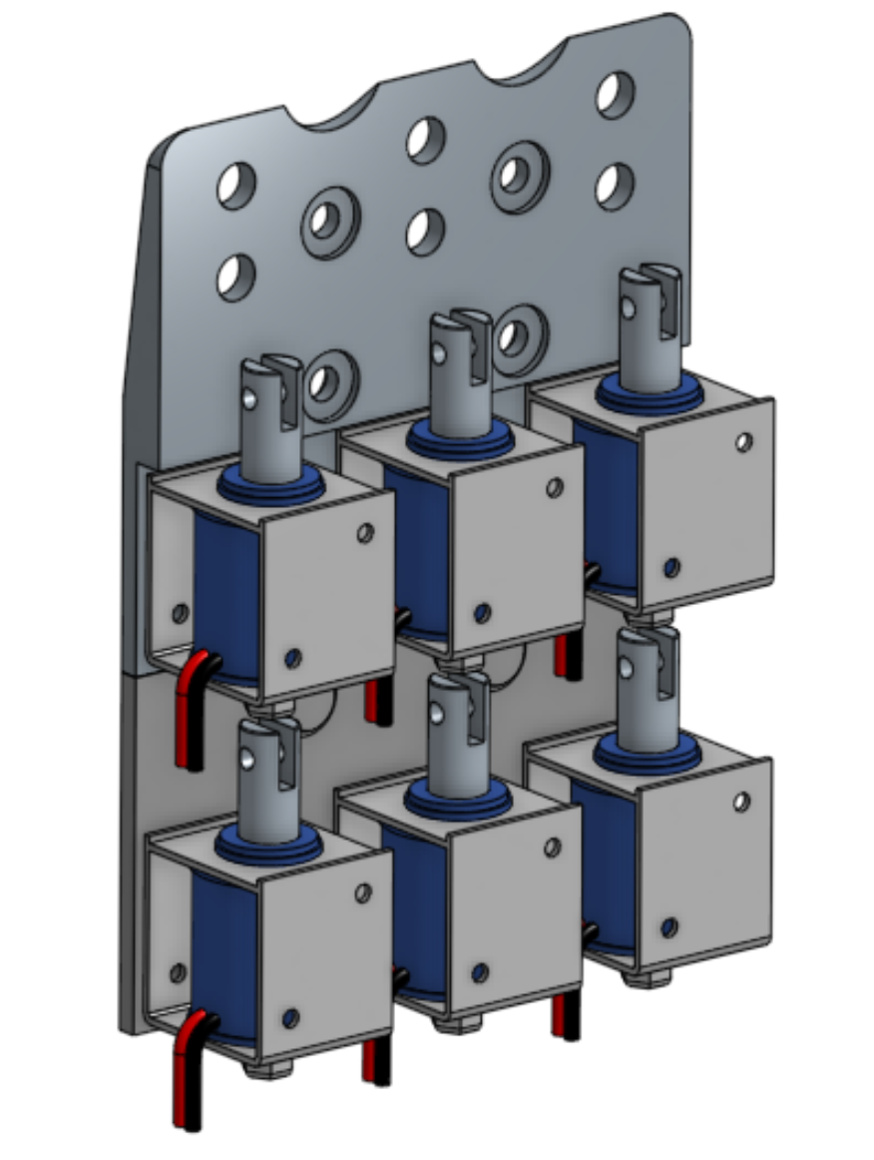
HAND-et V3?
The focus of further research and prototyping should be aimed at developing a robust mechanical system for the actuation of the trumpet valves.
Servo Implementation: Higher torque and force capabilities in same volume.
Linear to Rotary Movement: Finger and actuator movement match. Rotary movement from servos allows for two opportunities for lever arms.
Force Translation: Utilizing on-stretch cabling or string allows for consistent force on all components which increases repeatability.
Figure 10: Perspective view of multi-solenoid system with extension plate.
Notes:
Zoe

Slide 25
HAND-et V3?
The focus of further research and prototyping should be aimed at developing an electronic tuner with an analog microcontroller.
An Analog input microcontroller should be developed/sourced out
A more robust program should be developed
Noise filters should be applied to the signal
Notes:
Anna

